Slide 1
Smart Plant Watering Device – Iot Based
VIT Bhopal

Slide 2
Our team and their past works
Bibi Izna 20BCE11021 | Solo- Weather forecast website Group- Fit-o-cracy (Fitness and diet plan website), Going Dutch (split bill application) Github profile- https://github.com/Izna1021
Yaksh Goyani 20BCE10483 | Group- Student management system Github profile- https://github.com/yksh17
Sheril Rastogi 20BCE10838 | Solo- Ipod Playlist, taxi booking app Group- Music and gaming website Github profile- https://github.com/sheril04
Shivam Dubey 20BCE10133 Shaurya Verma 20BCE10186 | Solo-Music band Webpage, Credit card fraud detection, Realtime chat application Github profile- https://github.com/ShivamDubey20 Online shop – https://e-web-aaa62.web.app/

Slide 3
03
02
04
01
Table of contents
Existing work
Solution
Why is it unique?
05
Problem Statement
Business Value
08
06
Extent of implementation
07
Implementation
Scalability

Slide 4
Introduction
The most significant cultural practice and the hardest duty in everyday operations are both watering the plants. No matter whichever weather it is, either too hot and cold or too dry and wet it is very crucial to control the amount of water reaches to the plants.
During the lockdown period, the majority of households began gardening since they could produce any plants they wanted for daily usage, including fruits, vegetables, and other plants. However, as restrictions are gradually lifted and people can resume their regular lives, they find it harder to maintain their plants' health and viability since they lack the time to water them.
Soil erosion is also one of the problems in degradation of plant life. While watering a plant or a tree, the water content must be accurate. Many ignore this problem causing an exploitation of plants or trees.
Water shortage is currently the biggest issue facing the planet, and as agriculture is a labor-intensive industry that uses a lot of water, therefore a system is required to use the water efficiently.

Slide 5
Problem Statement
In the course of their daily activities, many people frequently forget to water their plants, making it difficult for them to maintain the health and life of their plants. Farmers also face difficulties managing the watering of plants and maintaining their fields when there is a water shortage.
Many ignore soil erosion causing an exploitation of plants or trees. Most of the farmers use large portions of farming land and it becomes very difficult to reach and track each corner of large lands . Additionally, it might be difficult for farmers to keep their fields in good condition and control plant irrigation when there aren't enough rains or water supplies. This causes crops to be of poor quality, which further causes financial losses.
Therefore a system is required to use the water efficiently and save time required to water plants.

Slide 6
Solution
The main objective of our work is to develop a smart and automated watering system for plants.
We believe that technology can help people in cultivating plants, not just by automation but also through digital communications. We thought that it is necessary to put into place an automated system that will take care of plants while taking into account all the various elements of home gardening systems (for systems based on household purposes) as well as larger landscapes (for systems based on agricultural farms) and promotes their healthy growth.
Automated systems are accurate, dependable, flexible, and need fewer manual procedures. The internet of things (IoT) industry saw a substantial transition as a result of the expansion of things from data provided by devices to actual physical items. So, we made the decision to use IoT to automate the garden job.
With our new solution, gardeners can monitor some important factors like the health of their plants, the moisture content of the soil, the humidity in the air, and the local temperature at any time, from anywhere. An important aspect of this project is that: “when and how much to water”. Therefore, our project aims to implement a simple system, using automatic irrigation, watering a small potted plant or crop with minimal human Intervention .
To reduce manual activities for the human to watering plant, an idea Smart Plant Watering System using Latest IoT technology is adopted.

Slide 7
Background and existing work
These are few works and research papers which have been done in this field
An overview of smart irrigation systems using IoT
https://www.sciencedirect.com/science/article/pii/S2772427122000791
Overview of ESP8266 Wi-Fi module based Smart Irrigation System using IOT
https://ieeexplore.ieee.org/abstract/document/8480949?casa_token=tE2yx5uzQd4AAAAA:oj079gxkE1NF_bIfIgbkDeyGGoPeB7DJfzq2DWVwCJhtegD9HNkkzX75Yxiq1yrzelyVZQst
Smart Plant Watering System with Cloud Analysis and Plant Health Prediction.
https://www.sciencedirect.com/science/article/pii/S187705092030096X

Slide 8
Will the idea deliver business value ?
Smart plant watering system uses only the amount of water that is necessary and involves no or little human intervention. The components used are cheap and easily available.
One of the additional advantages is high cost-efficiency since it reduces prices and total expenditures because it uses less water and is more precise in its operation.
As a result of the method's planned breaks and shorter operating times for equipment, which use less energy generally overall, energy consumption is also greatly decreased.
Additionally, because resources are few and companies must manage costs to some level, it is critical to reduce expenses and save resources. With Smart plant watering system, the cost aspect is taken into account, making it possible to carry out associated tasks successfully while spending less money.
Last but not least, one of the additional benefits is that with improved irrigation efficiency and water management, Labor expenses can be reduced.

Slide 9
Why is it unique?
Our invention stands apart from other watering-plant technologies on the market today because it has a built-in feature that notifies the user periodically about the health of the system and plant.
It will be incredibly affordable and simple to use and comprehend.Although this concept has been well proven in broad areas, it has not been applied to home gardens and plant nurseries, where it is just as necessary.
By utilizing our gadget, users can keep an eye on vital information like the health of their plants, the moisture content of the soil, the air's humidity, and the temperature of their surroundings, as well as water their gardens whenever and wherever they are.
This system is very easy to set up and can be controlled using a smartphone or computer.
The current approaches don't have a capability to forecast and tell the farmers about the health condition of the plant, nor do they follow a practical strategy to visualize the recorded sensor data graphically.
In order to determine whether to release water from the electric motor or not, our design involves analysing the moisture content and temperature of the environment in which the plant grows.
The data from the sensors will be graphically displayed on an IOT platform (hardware and software interface), and this is then used to assess the health of the plant.
Thus, the technology irrigates the plants while conserving water and avoiding the compulsion for continuous human supervision.

Slide 10
Implementation

Slide 11
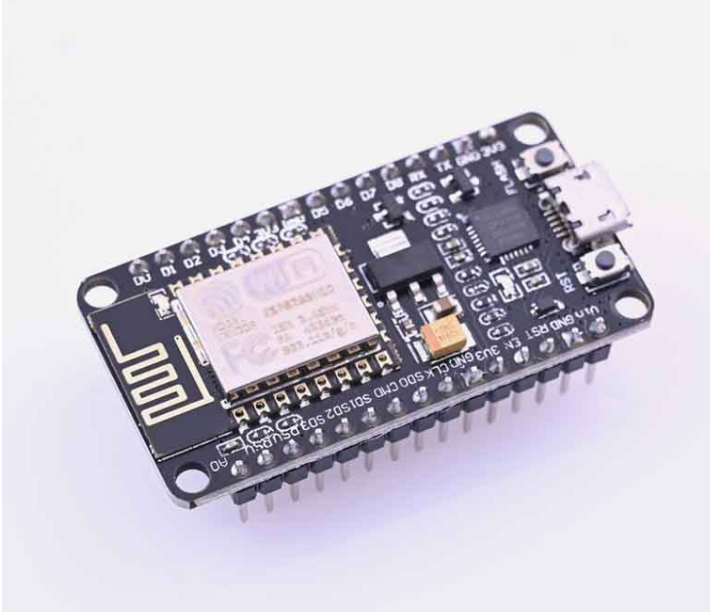
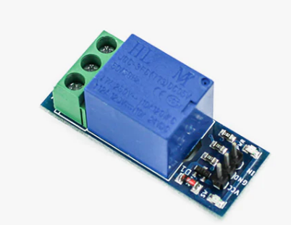
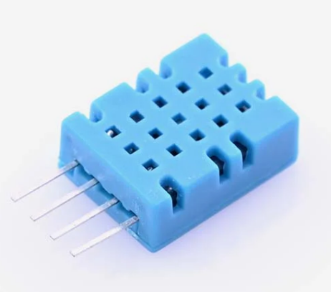
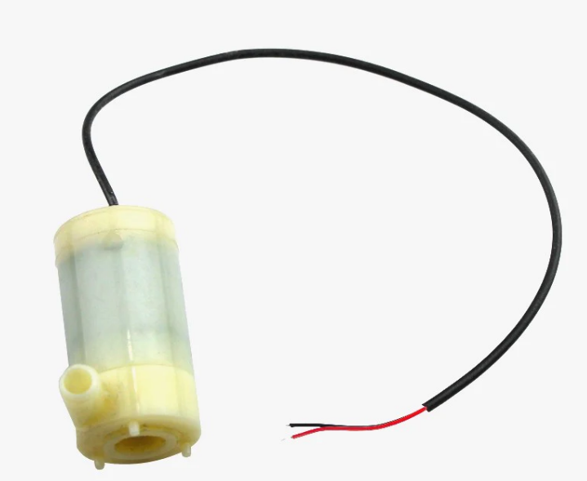
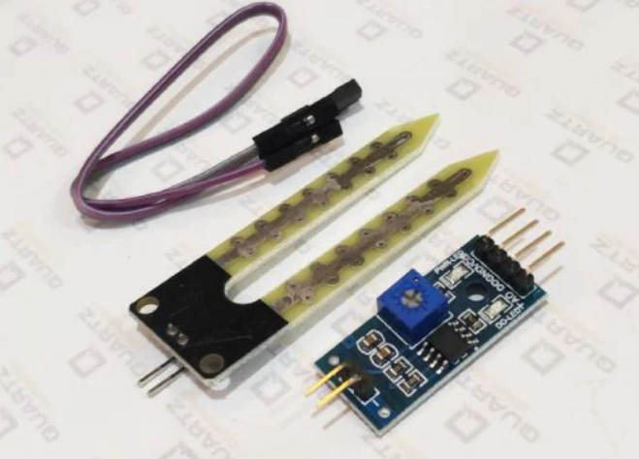
Components required
5V 10A
ESP8266
DHT11
Relay Module
NodeMCU CP2102 WIFI Development Board
Temperature and Humidity Sensor
3V to 12V Mini DC
Sensor
Submersible Pump
Soil Moisture Sensor Module

Slide 12
Working
We want to create an IoT-based irrigation system utilizing the DHT11 sensor and ESP8266 NodeMCU module. In addition to autonomously watering the plants depending on the soil's moisture content, it will also send data to a server to monitor the soil's health. The System will have a water pump that will be utilised to spray water on the soil based on factors including moisture content, temperature, and humidity.
In order to start watering a plant, this watering system employs sensors to determine when it needs to be watered. Additionally, sensor data will be shown graphically. This system is incredibly simple to set up and can be operated on a computer or smartphone.
Small plants or plants that don't require a lot of water are ideal candidates for this method.
This system functions as a smart switching system that monitors soil moisture level and irrigates the plant as needed using sensor technologies, microcontroller, and other electronics. There is a broad range of options for implementing these systems as a long-term solution for many agricultural and medical difficulties, even though the system developed in that method would be the most ideal for home usage as a remedy for certain everyday and common challenges.

Slide 13
Flowchart
Start
Read soil moisture detector reading
Read temperature and humidity sensor reading
Compare the values
Not matches
Matches
Turn on/off pump

Slide 14
ADVANTAGES
SAVE TIME: system will do all the watering for user.
SAVE WATER: An automatic system uses less water than watering by hand.
SAVE MONEY: Your water bills will be lower and your plants will live longer.
Weather efficiency.
Less stress.
Works according to the soil condition.
No nutrition pollution is released into the environment because of this controlled system.
This technology can water plants just when necessary without requiring human participation, making it especially handy for people who work regular jobs and travel often.
Complete elimination of man power.

Slide 15
Scalability
The output of the humidity sensors is essentially what determines how well the project will operate.
Sensor technology cannot be used when the desired field requires more water than is available.
Therefore, we must incorporate new technologies, such as Bluetooth. This will allow us to more effectively water the intended land in the necessary amount.
Currently, we are working on a small-scale application of this project, but with the right direction and funding, there is a wide range of potential applications for these systems in the future as a long-term fix for many agricultural and medical issues.

Slide 16
Extent of Implementation done
We have figured out the solution to our problem and have been working on it for the past week.
Our Team is currently working on the code to programme the micro-controller.
Meanwhile, all the components have been ordered and our team will start working on physical circuit soon.
Technical parts, such as platform selection for the app, software we will be using, code for programming the components are being selected and tested by our team.

Slide 17
Conclusion
This system will be able to contribute to the socio-economic growth of the country with quick response and user-friendly features.
The work is designed and implemented in such a way that it is much easier and cost effective.
The practical application of this technology is now conceivable thanks to recent developments in soil water sensing, which automate irrigation control for vegetable production.
However, research shows that various sensor types operate in all environments without affecting crop yields, and can use up to 70% less water than conventional methods.

Slide 18
THANK YOU

